Slide 1
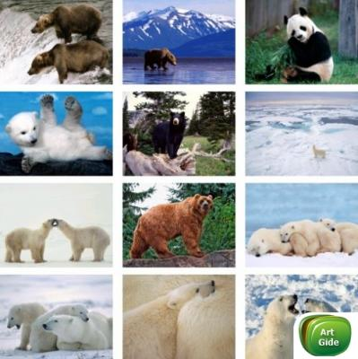
Wild animals

Slide 2
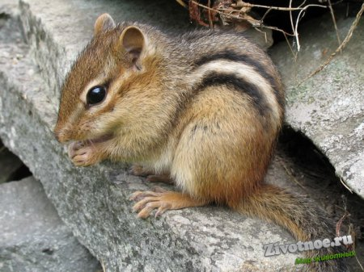
The chipmunk concerns a sort of rodents and family of the squirrel. Coloring of chipmunks varies from is red – brown to a gray little body with five dark strips on a back of a small animal.
The chipmunk – the small animal living in basic in the North America, but lives twenty five versions and on the Eurasian continent.

Slide 3
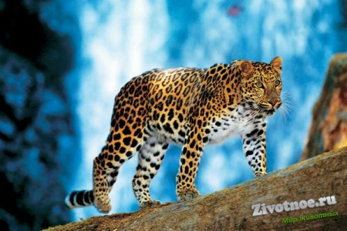
Leopard - one of the largest animals of family cat's, concerning a sort a panther.
The leopard represents large enough well-muscled body, the roundish form a head, short dense wool and a long tail. With characteristic feature which allocates all kinds of leopards their coloring consisting in the form of a lurid background, from black continuous ring-shaped stains scattered on a body is.

